Slide 1
Classification and Clustering
Paula Seidler

Slide 2
Recap
Prediction Modelling
Supervised Learning -> labelled data
Regression: predict the value of one variable based on the values of other variables
Unsupervised Learning -> no labelled data

Slide 3
Contents
Prediction Modelling
Supervised Learning -> labelled data
Regression: predict the value of one variable based on the values of other variables
Classification: predict categories or classes based on input data
SVM
Random Forest
Unsupervised Learning -> no labelled data
Clustering: grouping similar data points based on patterns
K-Means

Slide 4
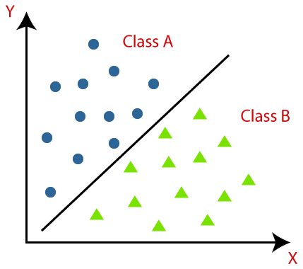
Overview of Classification
Classification is is a machine learning technique used to categorize data into distinct groups or classes. It helps us assign labels to new data points based on patterns learned from past data.

Slide 5

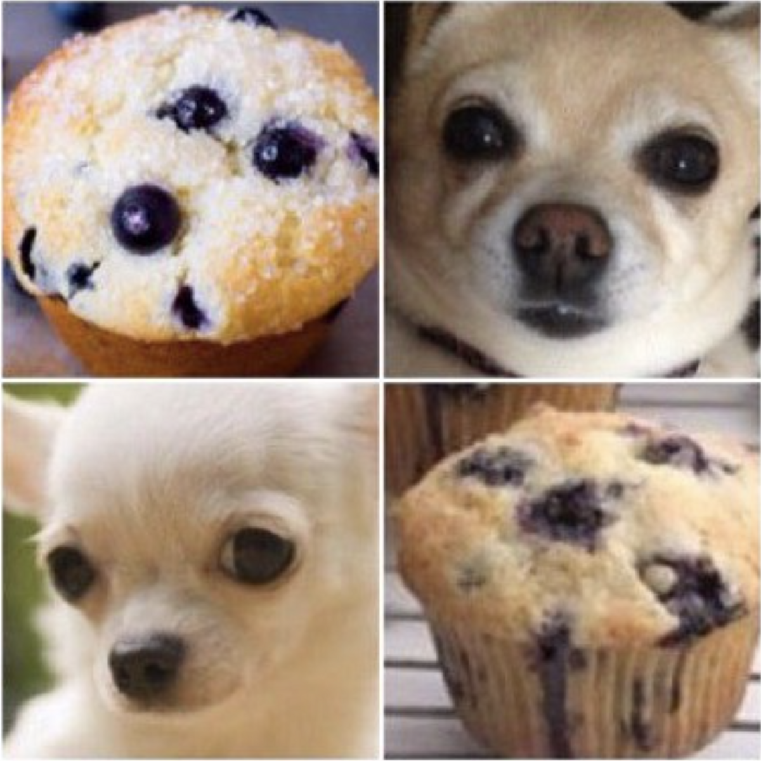
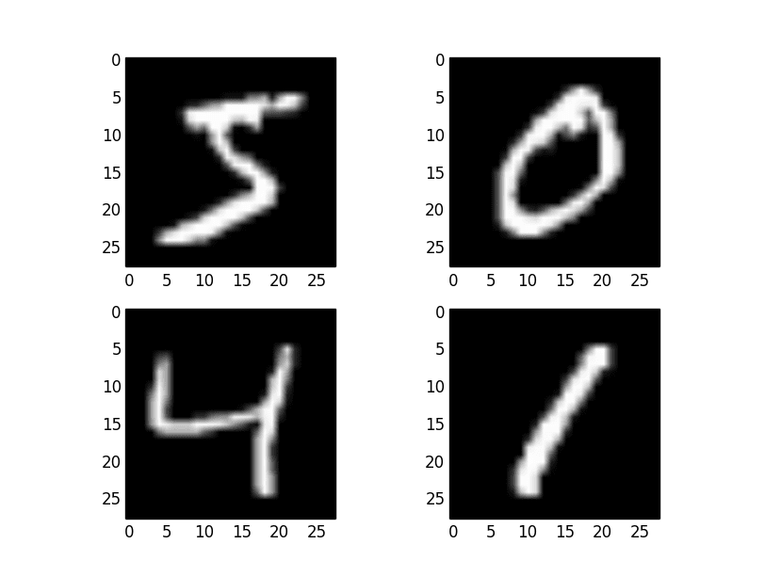
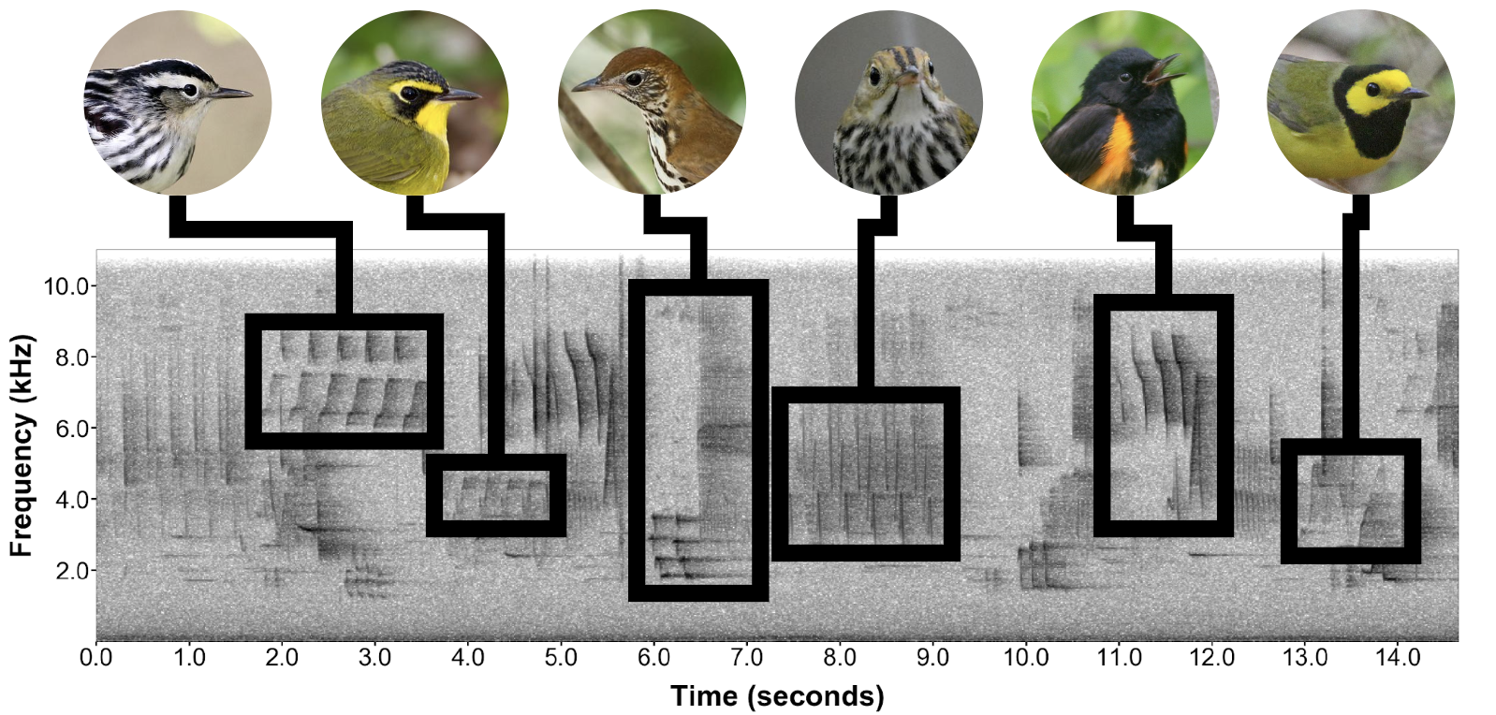
Examples
Which Iris Flower?
Handwriting -> Which Digit?
Dog or muffin?
Species identification based on audio
-> Can you think of more?

Slide 6
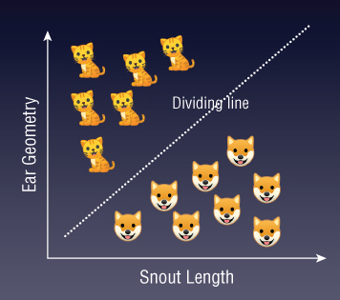
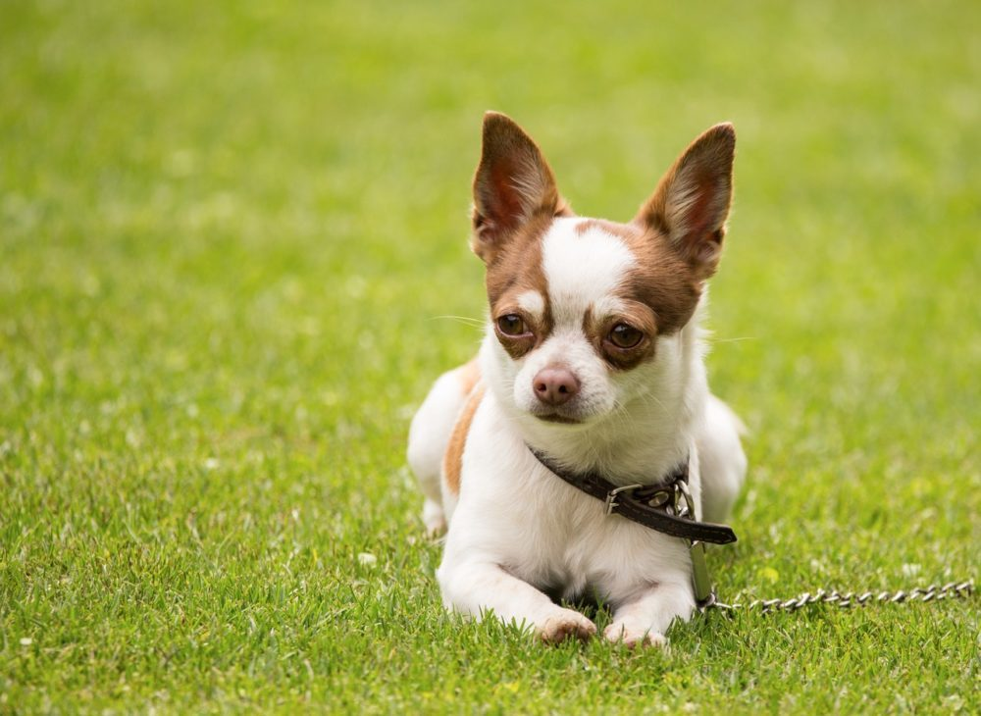
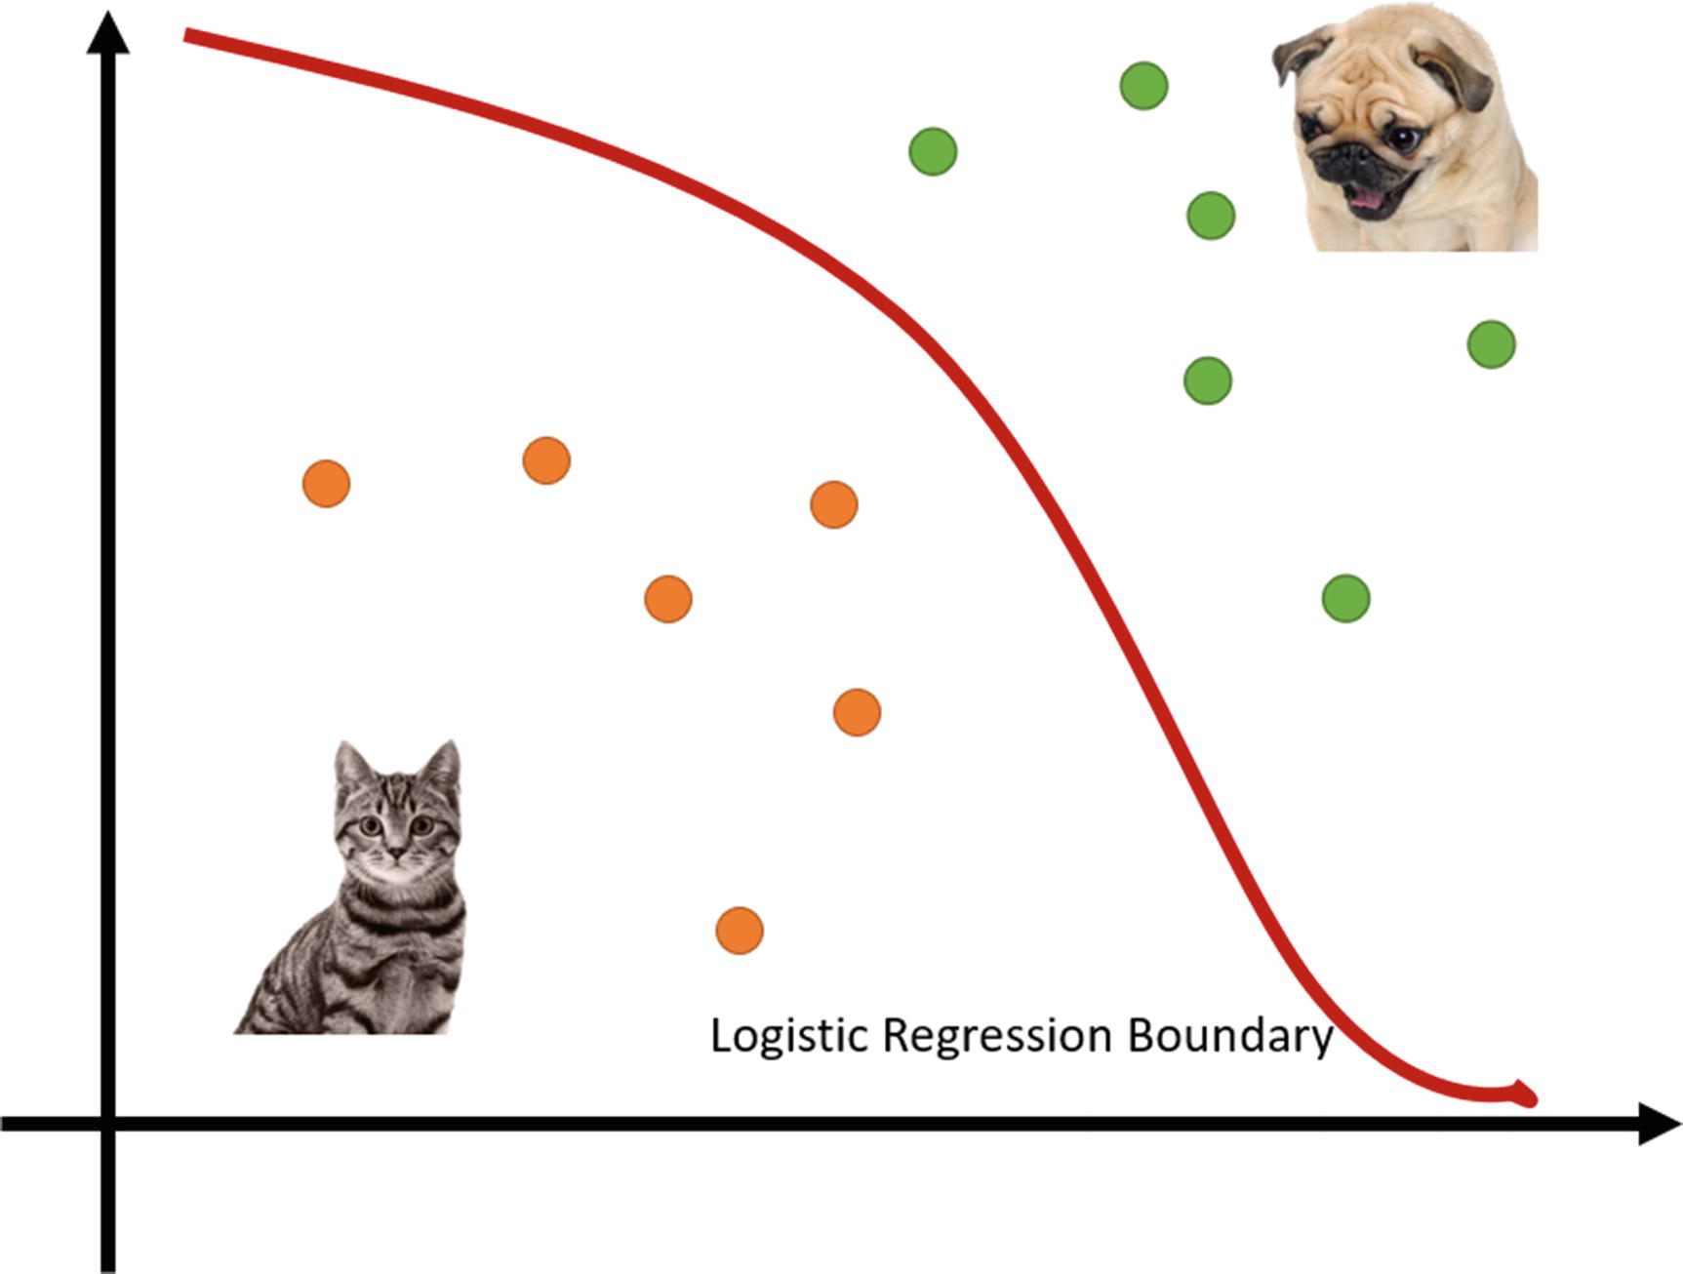
Binary Classification
Goal: find decision boundary (dividing line between classes)
Logistic Regression
SVM
Probability(Cat)
Geometrically
Probabilistically
Cat or Dog?
Features(weighted)

Slide 7
Binary Classification - SVM
Goal: find lower-dimensional decision boundary - hyperplanes
-> Separates classes in the feature space
-> Cat X
Cat or Dog?

Slide 8
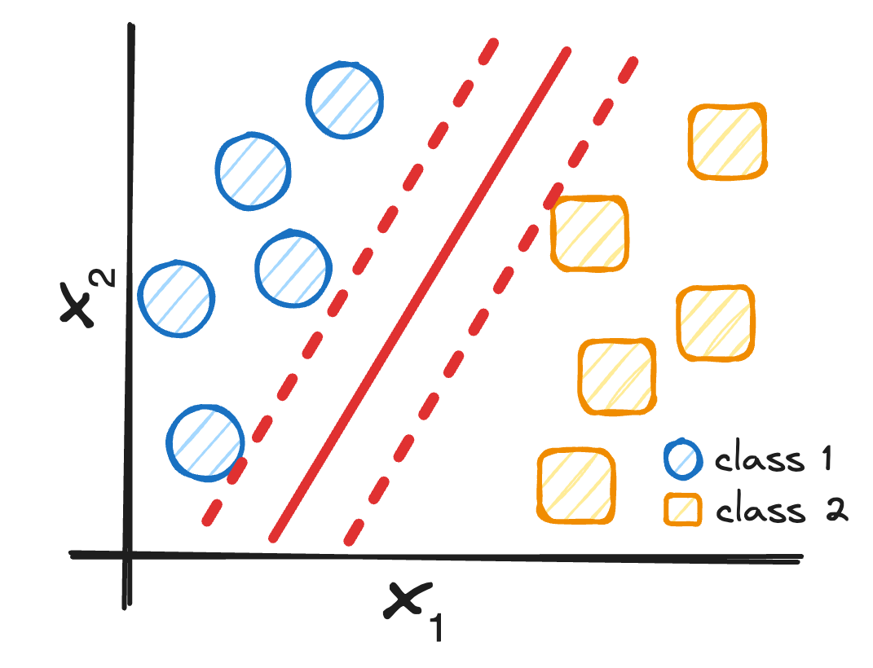
SVM - finding the optimal hyperplane
Goal: find hyperplane that maximizes the margin between the support vectors
w⋅x+b=0
distance
nearest points of each class

Slide 9
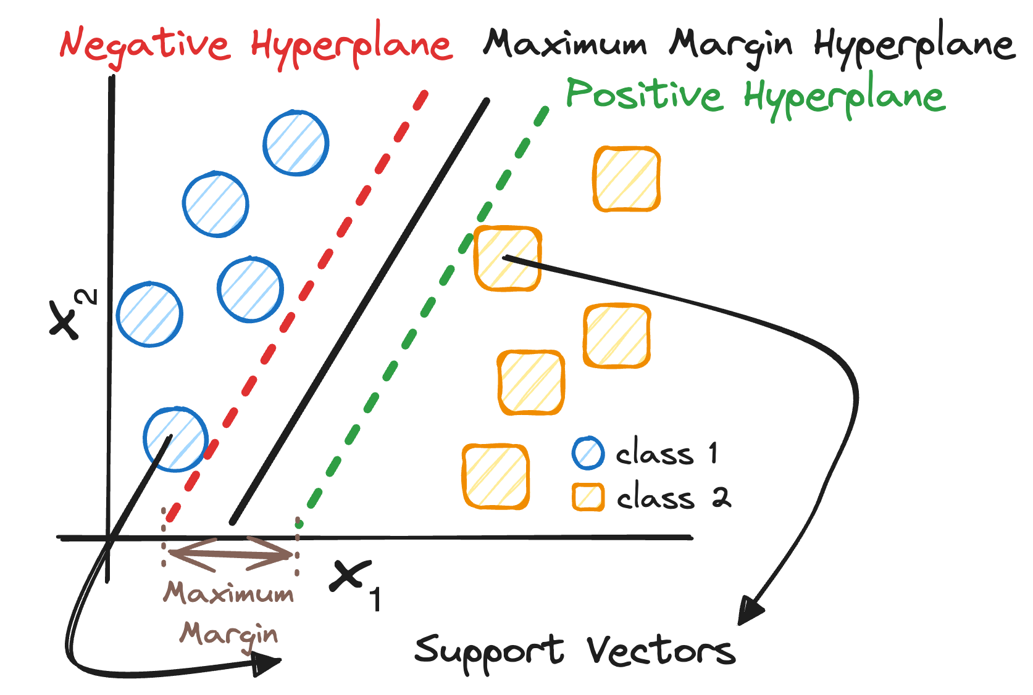
SVM - finding the optimal hyperplane
Goal: find hyperplane that maximizes the margin between the support vectors
w⋅x+b=0
distance
nearest points of each class

Slide 10
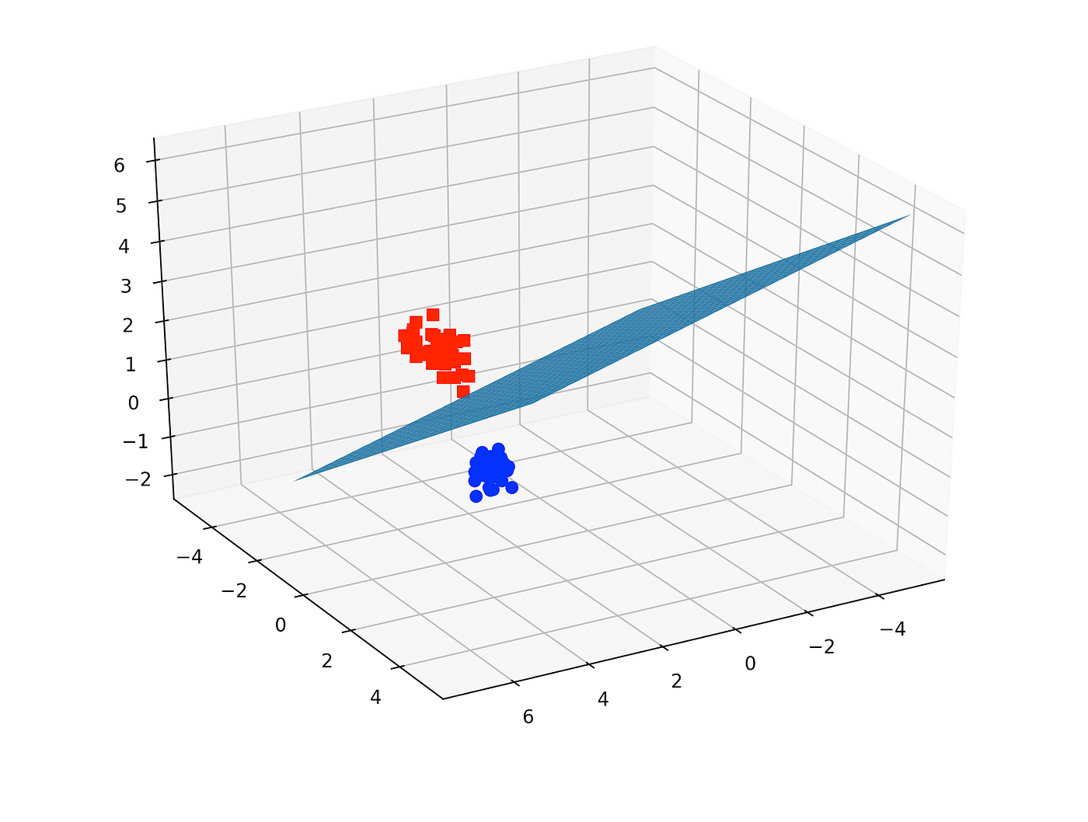
Higher Dimensional Data
More features -> higher dimensional hyperplanes

Slide 11
What if we have non-linearly separable data?
-> no optimal hyperplane possible!
Standard SVM fails when data is not linearly separable.
Solutions:
Soft Margin SVM: allows misclassification by changing constrain function
Kernel Trick: maps data into higher dimensional space

Slide 12
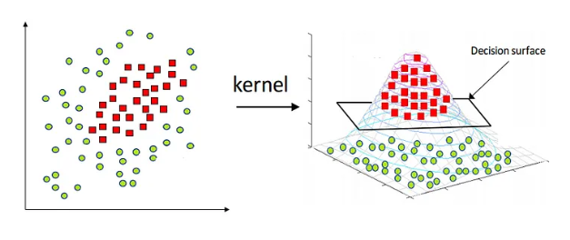
Kernel Functions
Use a kernel function to transform data into a higher-dimensional space before finding hyperplane.
Common Kernel Functions:
Linear: no transformation, standard SVM
Polynomial: curved decision boundaries
RBF (Gaussian), Sigmoid: non-linear data, complex patterns
-> choose based on complexity of your data/classification problem!

Slide 13
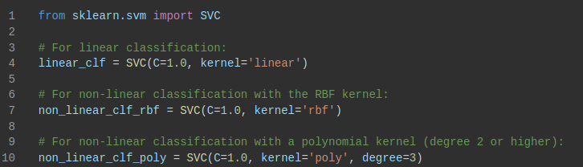
Coding it

Slide 14
Pros - SVM
Handles high-dimensional data well
Good performance for most classification tasks
Easy to understand and implement
Robust to overfitting
Finds the optimal hyperplane

Slide 15
Limitations - SVM
Struggles with non-linearly separable data unless using complex kernels
Inherently binary - relying on ensemble methods for multi class classification
Sensitive to Noise

Slide 16
Binary Classification
Goal: find decision boundary (dividing line between classes)
Logistic Regression
SVM
Probability(Cat)
Geometrically
Probabilistically
Cat or Dog?
Features(weighted)

Slide 17
Binary Classification - Logistic Regression
Goal: find probabilistic decision boundary -> probability of belonging to a class
Probability(Cat)
Cat or Dog?
Features(weighted)

Slide 18

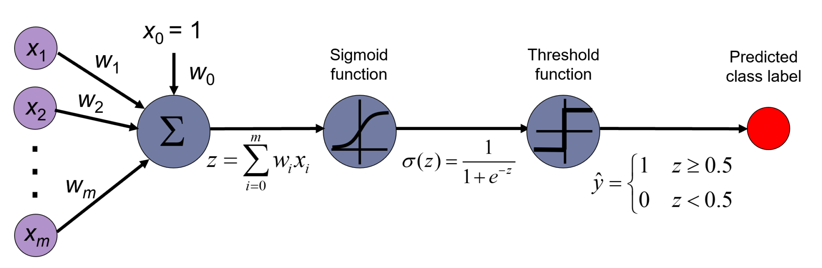
Logistic regression
There are many important research topics for which the dependent variable is "limited."
For example: voting, mortality, or number of accidents is not continuous or distributed normally.
Z = X⋅W = w0 + w1​⋅x1​ + w2​⋅x2​ + … + wn​⋅xn
Uses the sigmoid function to enforce the classification
You can also have a bias term
Number of weights = number of features + one bias

Slide 19
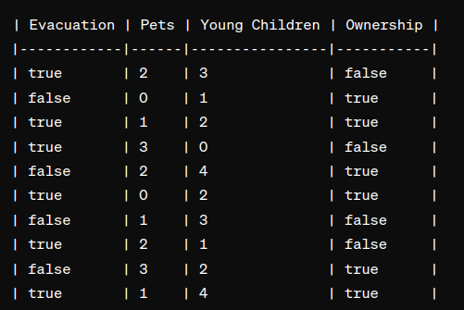
Example
There is a flood!
Based on characteristics can we predict who is not likely to evacuate so search and rescue teams can find them.
True and false will be represented as 1 or 0 for numeric compliance with the module
Evacuation is our y
The rest is our x

Slide 20
Randomly create our model
z=w⋅X+b
Y_hat = sigmoid(Z)
Let’s say all weights are = 0.1
Bias = 0.1

Slide 21
Randomly create our model
z=w⋅X+b
Y_hat = sigmoid(Z)
Let’s say all weights are = 0.1
Bias = 0.2
Item one: 2*0.1 + 3*0.1 + 1*0.1 + 0.2
= 0.8
Sigmoid activation = 1
Correct?

Slide 22
Randomly create our model
z=w⋅X+b
Y_hat = sigmoid(Z)
Let’s say all weights are = 0.1
Bias = 0.2
Item one: 0*0.1 + 1*0.1 + 1*0.1 + 0.2
= 0.4
Sigmoid activation = 1
Correct?

Slide 23
Training
Initialization: Initialize the weights (coefficients) and the bias term. ✅
Calculate the Predictions: Use the current weights to make predictions.✅
Calculate the Cost Function: Compute the cost function (log loss) based on the predictions.
Calculate Gradients: Compute the gradients of the cost function with respect to each weight.
Update Weights: Update the weights using the gradients and the learning rate.
Repeat: Repeat steps 2-5 until convergence (or for a fixed number of iterations).

Slide 24
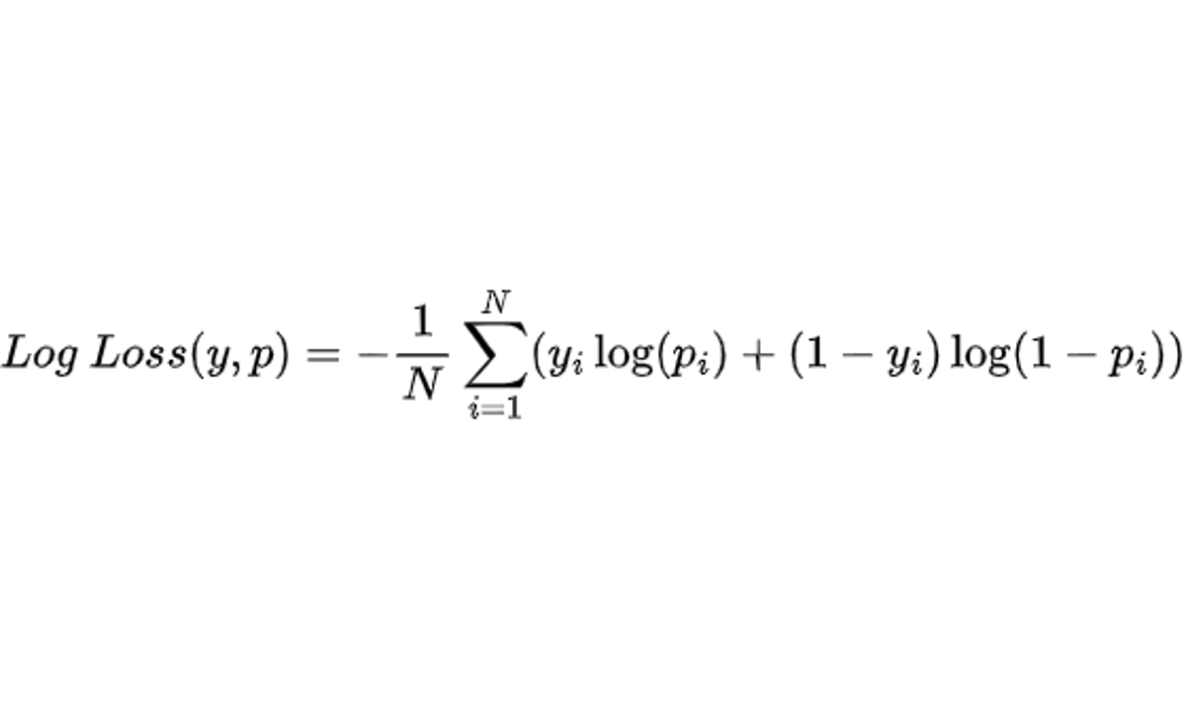
Log loss
Y is our values and p is our predicted
The log loss function penalises confident and incorrect predictions more heavily than uncertain ones.
It is commonly used as the evaluation metric for binary classification problems, especially when dealing with imbalanced datasets or when probabilistic interpretations of the predictions are important.
Notes:
ylog(p) = his term penalizes the model when the actual label (y) is 1 and the predicted probability (p) is close to 0. The logarithm ensures that this penalty increases as the predicted probability approaches 0. When y is 0, this term becomes 0 regardless of the predicted probability.
(1-y)log(1-p) = This term penalizes the model when the actual label (y) is 0 and the predicted probability (p) is close to 1. Similar to the first term, the logarithm ensures that this penalty increases as the predicted probability approaches 1. When y is 1, this term becomes 0 regardless of the predicted probability.
-1/n sum = This term calculates the average over all samples, effectively computing the mean log loss across the entire dataset.

Slide 25
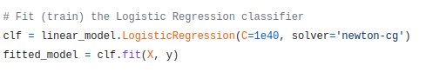
Code does this all for you!
Two lines!

Slide 26
Pros - Logistic Regression
Simple and interpretable
Probabilistic output (predicts probabilities)
Efficient for binary classification
Fast to train, requires fewer resources

Slide 27
Limitations - Logistic Regression
Assumes linear relationship between features and output
Struggles with non-linear data
Sensitive to outliers
Requires feature scaling for optimal performance
Can’t handle complex interactions between features

Slide 28

More complex classification problems
Random Forest

Slide 29
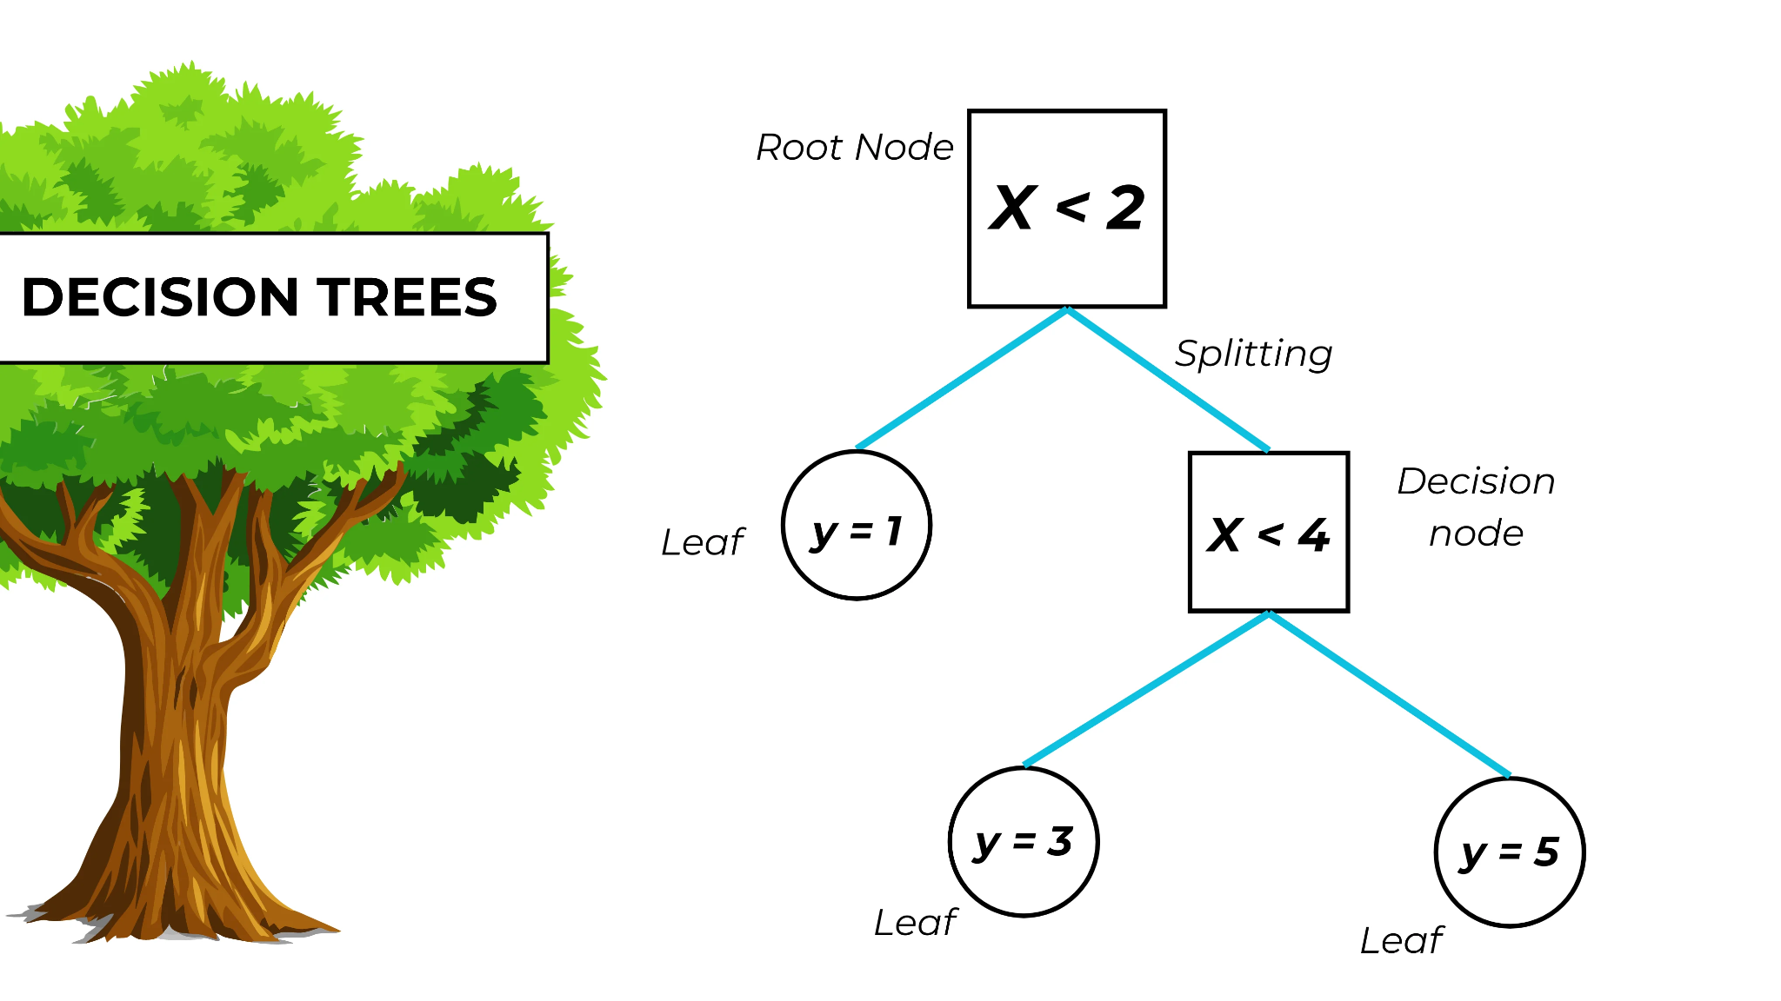
Decision Trees
Learns patterns in data by repeatedly splitting based on features, leading to a decision boundary that classifies the input data.
Root Node: Starting point
Decision Nodes: Split data based on features
Leaf Nodes: Final nodes with predictions
Output: Class label at the leaf node

Slide 30
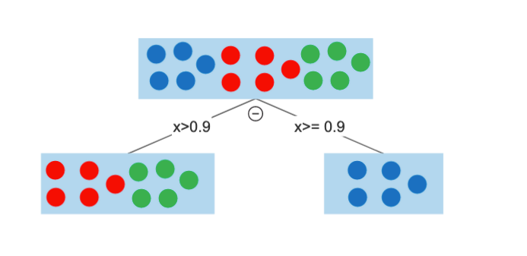
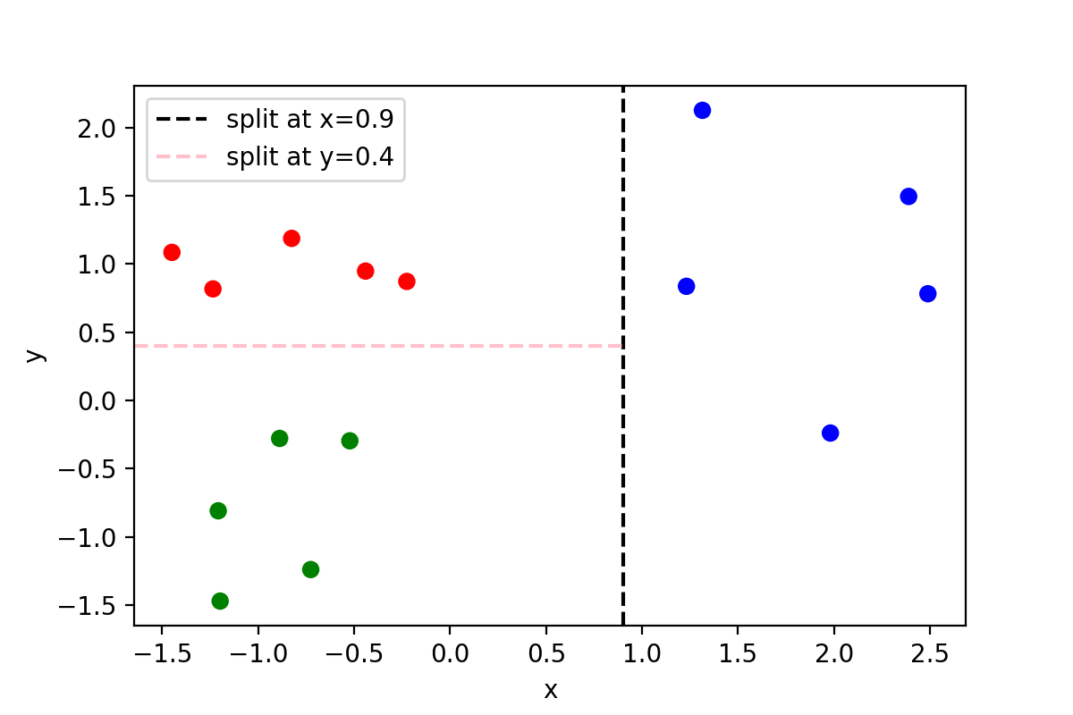
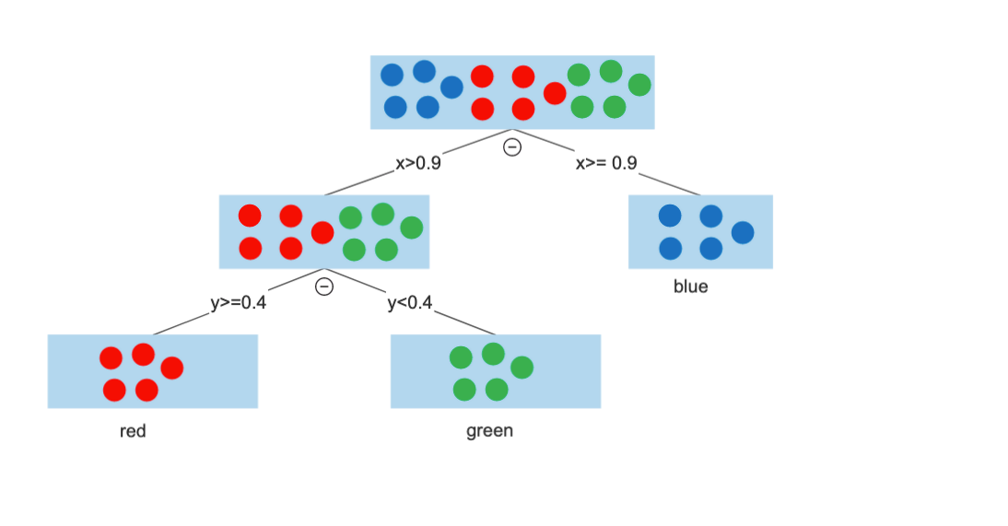
Example
1.
2.
-> How do we choose splits?

Slide 31
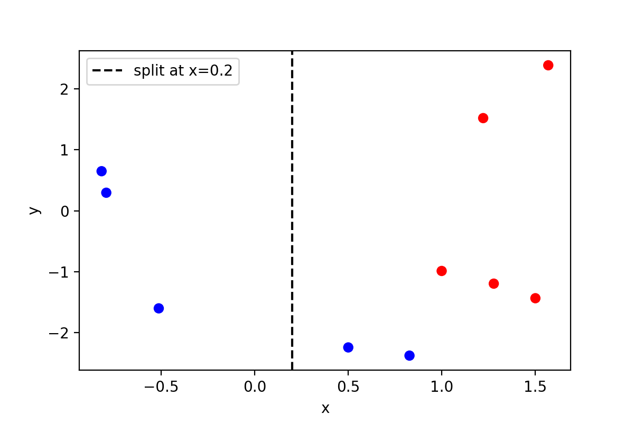
Learning in Decision Trees
-> choose splits that minimise “impurity” of a node:
Goal for each split - minimise “Gini” impurity of nodes
(3/3)*(1–3/3) + 0 = 0
(2/7)*(1–2/7)+ (5/7)*(1–5/7) = 0.4081
-> decision tree algorithm tries a lot of different splits, chooses best one based on Gini gain

Slide 32
Random Forest:
Ensemble of decision trees
Increase Accuracy by combining decision trees in parallel → reduces overfitting
Use a subsample of features for each tree (controlled by "max_features")
Decide by majority voting

Slide 33
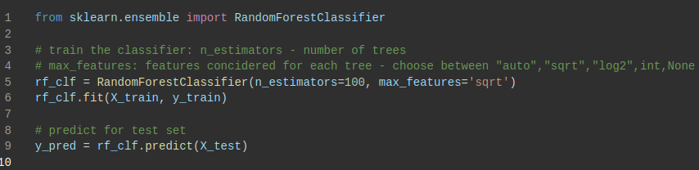
Coding it

Slide 34
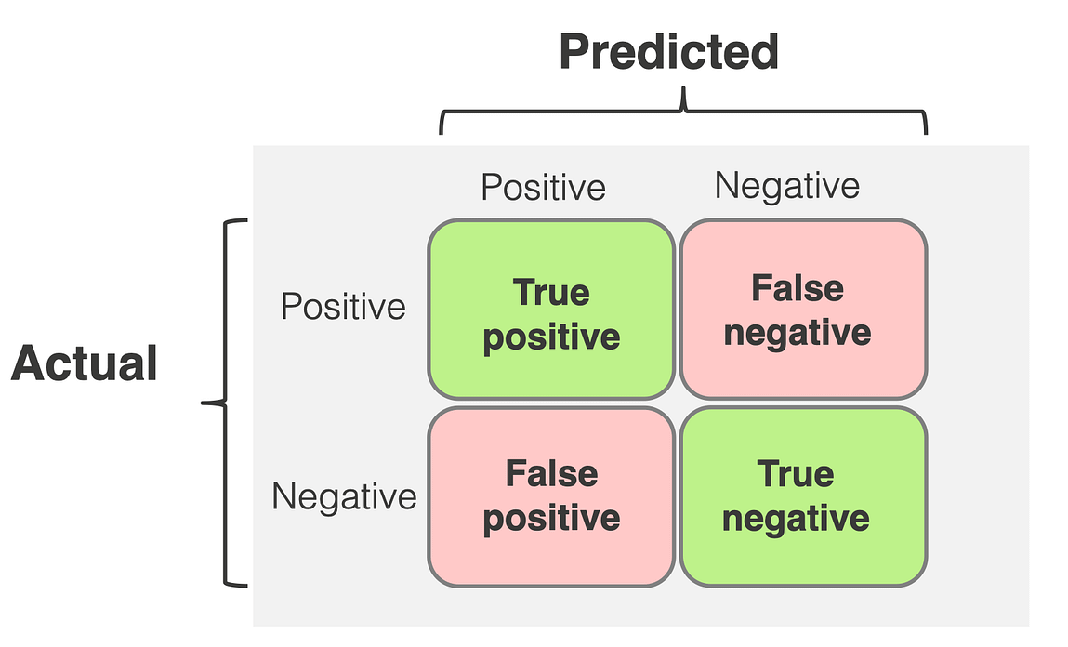
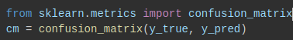
How does your classification model perform?
Accuracy: Proportion of correct predictions
Precision: Precision=TP/TP+FP
How many positive predictions are actually correct?
Recall (Sensitivity): Recall=FN/TP+FN
How many actual positives are correctly identified?
F1-Score: F1-Score=2×(Precision+Recall/Precision×Recall​)
Balances precision and recall

Slide 35
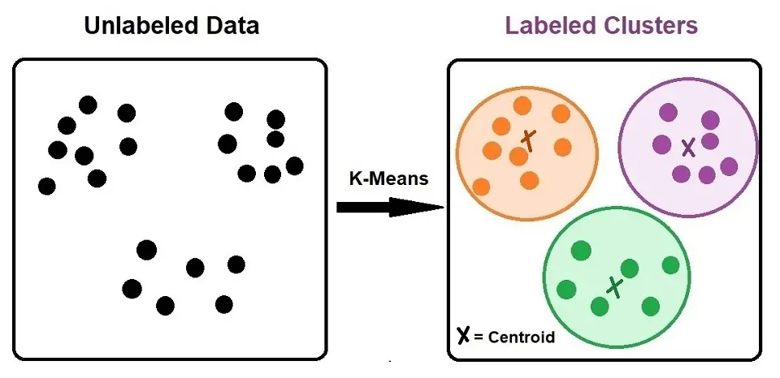
But what if we don’t know the classes? Clustering!

Slide 36
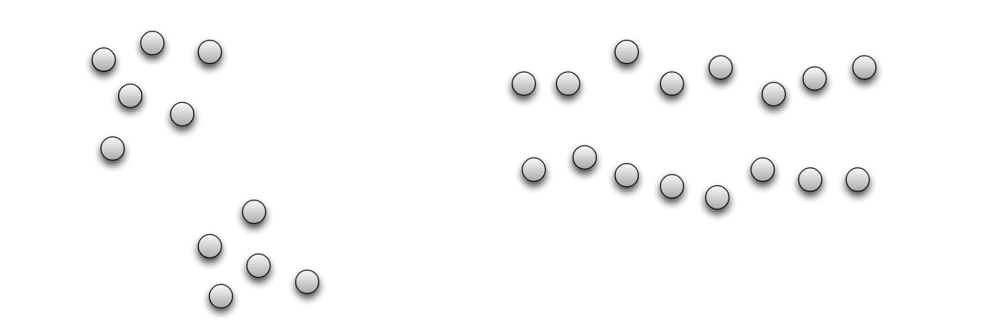
Clustering
Basic idea: group together similar instances

Slide 37
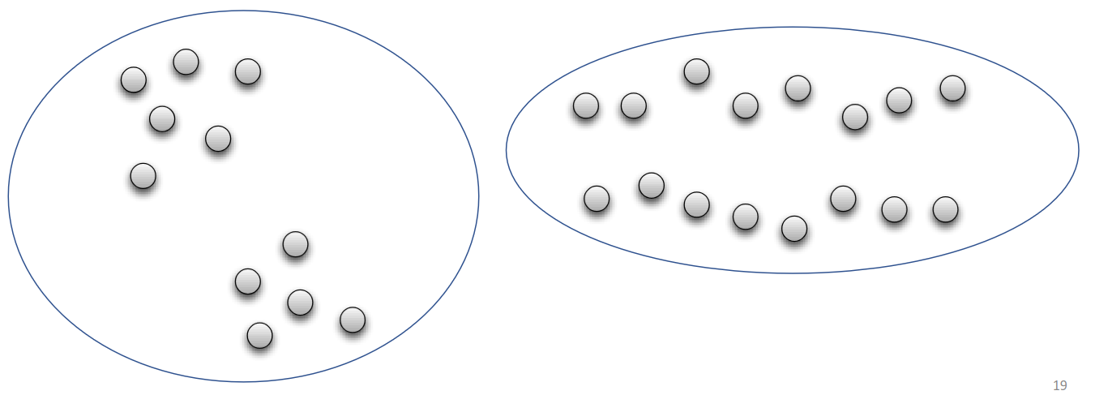
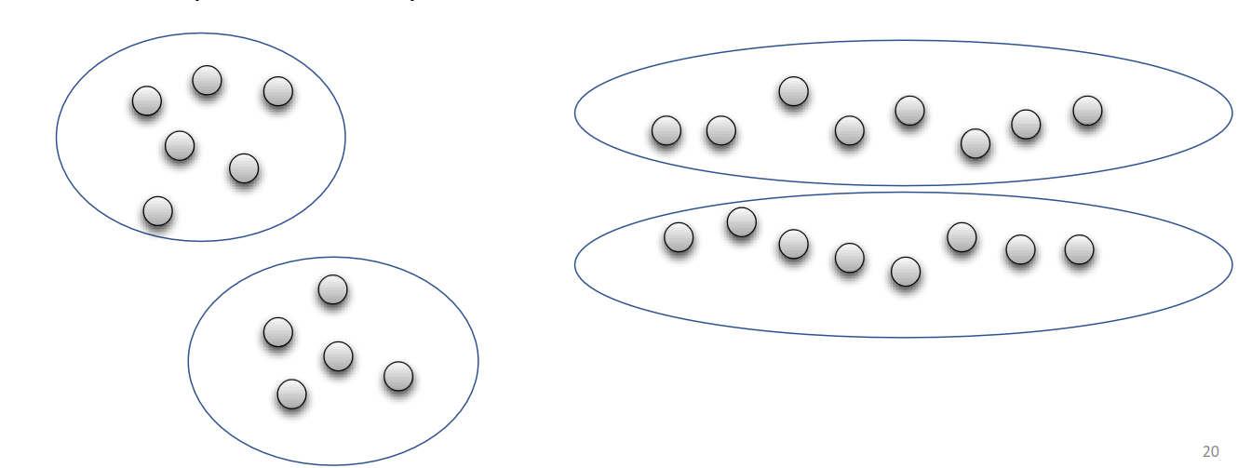
Clustering
Basic idea: group together similar instances
-> dependent on the measure of similarity (or distance) between “points” to be clustered

Slide 38
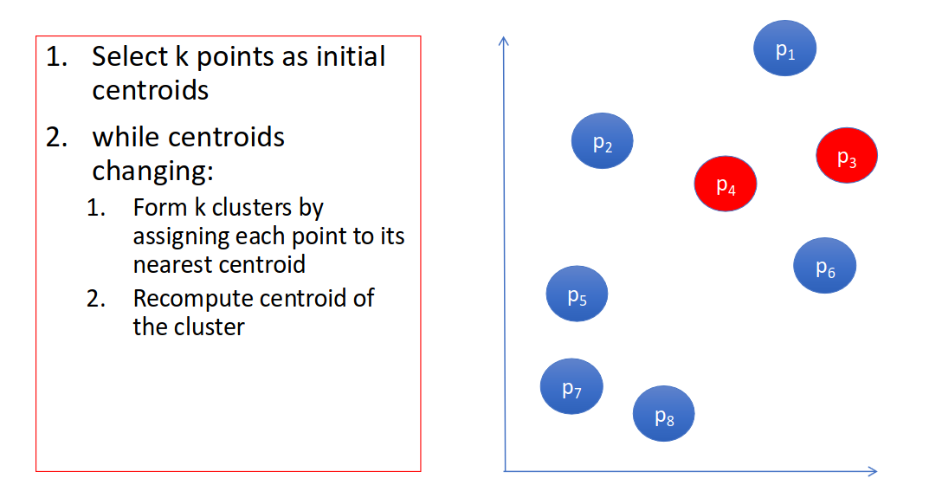
K Means Algorithm

Slide 39
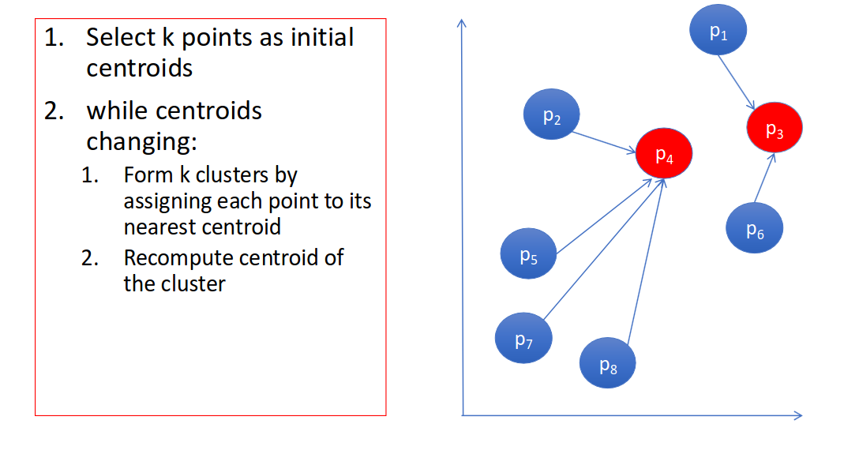
K Means Algorithm

Slide 40
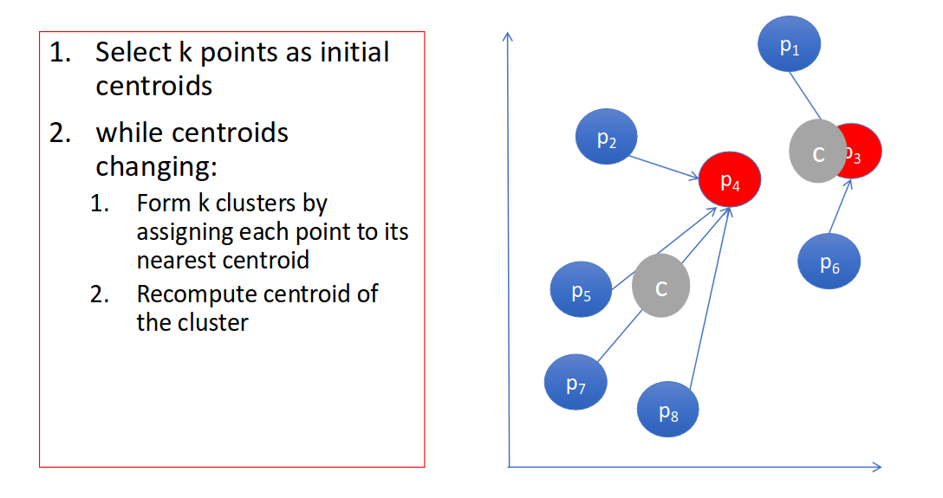
K Means Algorithm

Slide 41
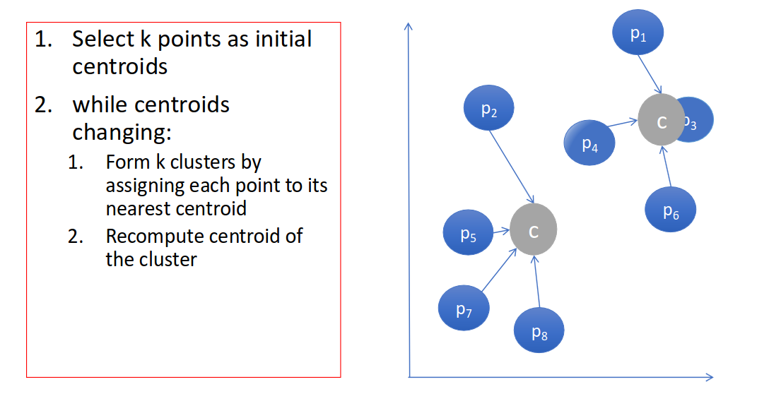
K Means Algorithm

Slide 42
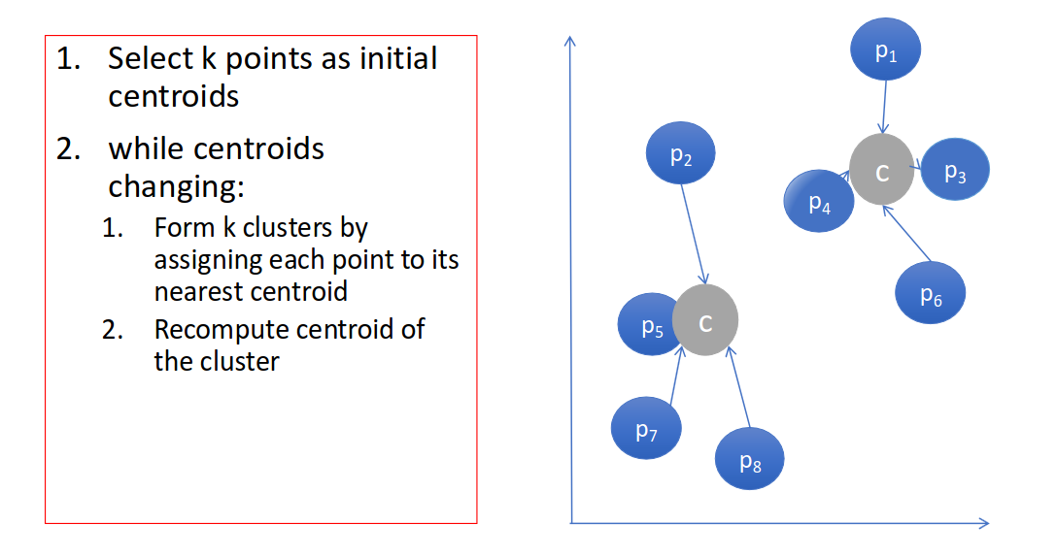
K Means Algorithm

Slide 43
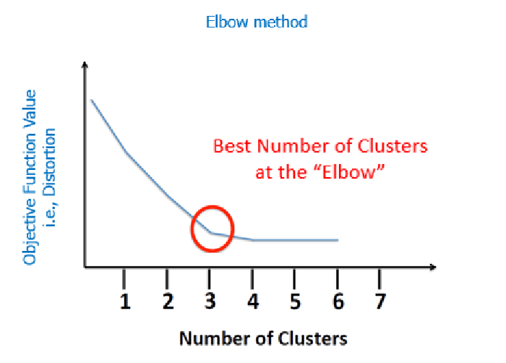
K-Means
How many clusters to choose?

Slide 44
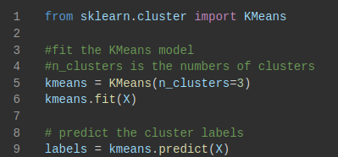
Coding it

Slide 45
K-Means Pros and Limitations
Pros:
fast, simple: no need to compute distances between all pairs of points; easy to implement
Limitations:
need to predefine k(the number of clusters)
may converge to suboptimal clusters (dependent on random initializations)
each point is assigned to one cluster
no hierarchical relationships (no clusters within clusters)
Alternative Clustering Methods:
Hierarchical Clustering, DBSCAN,...

Slide 46
Labs

Slide 47
First half
Look at the worksheet on GitHub for today!

Slide 48
Extension Material

Slide 49
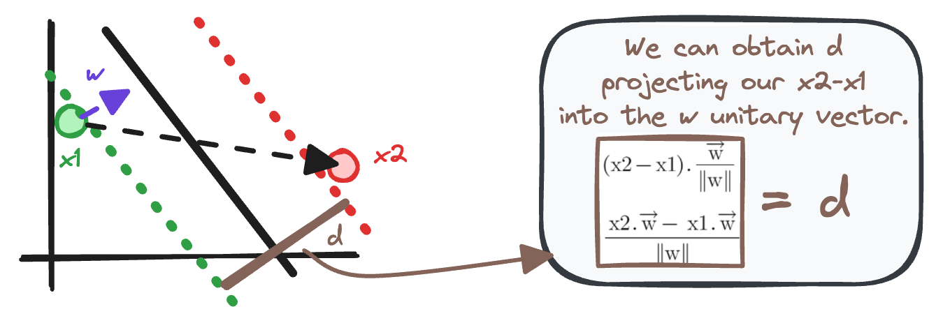
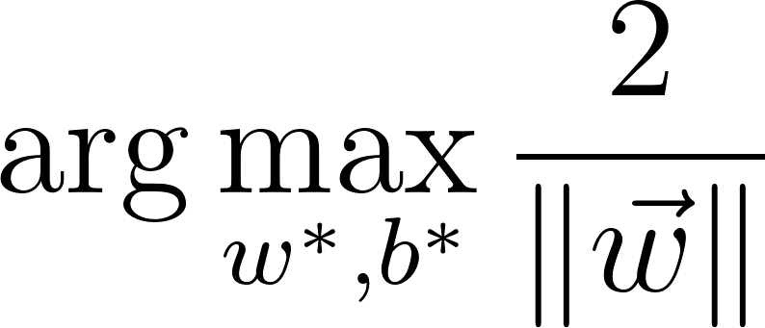
SVM - finding the optimal hyperplane
Goal: find hyperplane that maximizes the margin between the support vectors
w⋅x+b=0
distance
nearest points of each class
How to maximise margin d?
-> Minimize the norm of w!
Maximize d =
Notes:
W -> our slope for hyperplane
Norm of w -> perpend. To

Slide 50
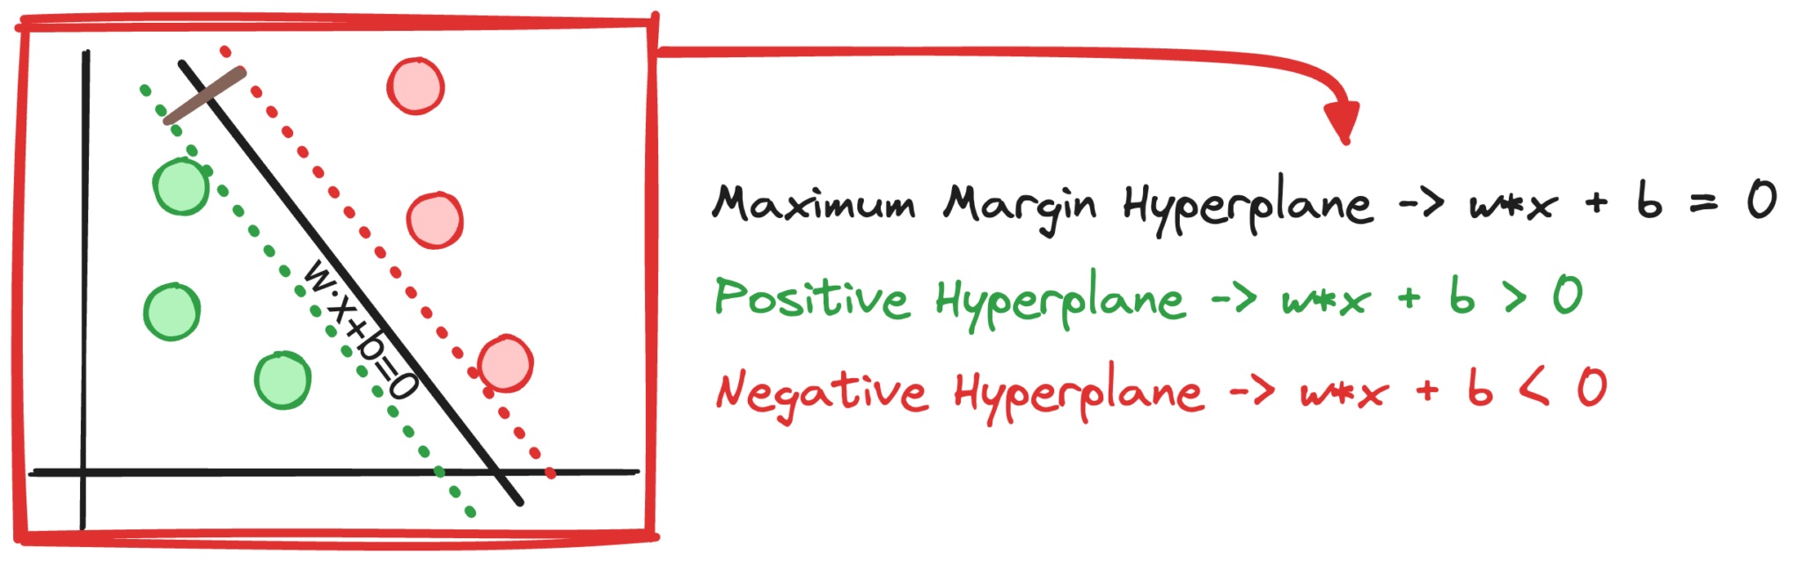
SVM - finding the optimal hyperplane
Goal: find hyperplane that maximizes the margin between the support vectors
w⋅x+b=0
distance
nearest points of each class
Constraints: Support vectors define the margin, ensuring a distance of at least one from the hyperplane.
Support vectors keep a distance of at least one from the hyperplane
Maximize d
such that

Slide 51
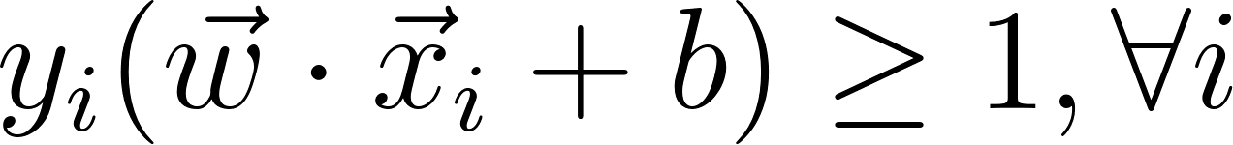
SVM - finding the optimal hyperplane
Goal: find hyperplane that maximizes the margin between the support vectors
w⋅x+b=0
distance
nearest points of each class
Constraints: Support vectors define the margin, ensuring a distance of at least one from the hyperplane.
such that

Slide 52
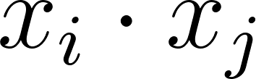
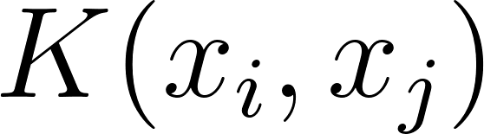
Kernel Functions
Replace the dot product with a kernel function to transform data into a higher-dimensional space.
Common Kernel Functions:
Linear: no transformation, standard SVM
Polynomial:curved decision boundaries
RBF (Gaussian), Sigmoid: non-linear data, complex patterns
-> choose based on complexity of your data/classification problem!

Slide 53
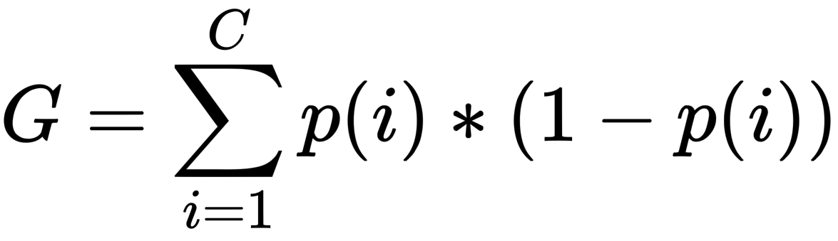
Learning in Decision Trees
-> choose splits that minimise “impurity” of a node:
Formular Gini impurity:
Goal for each split - maximise Gini gain: the difference in Gini impurity before and after the split
(3/3)*(1–3/3) + 0 = 0
(2/7)*(1–2/7)+ (5/7)*(1–5/7) = 0.4081
-> decision tree algorithm tries a lot of different splits, chooses best one based on Gini gain

